Slide 1
Applied Statistics, Probability theory and mathematical statistics
István Fazekas, Attila Barta, Sándor Pecsora
Nonparametric statistics
”This work was supported by the construction EFOP-3.4.3-16-2016-00021. The project was supported by the European Union, co-financed by the European Social Fund.”

Slide 2

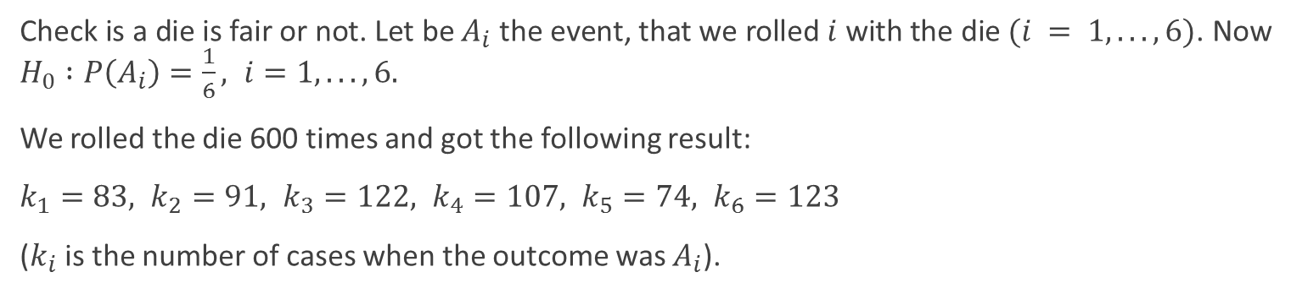
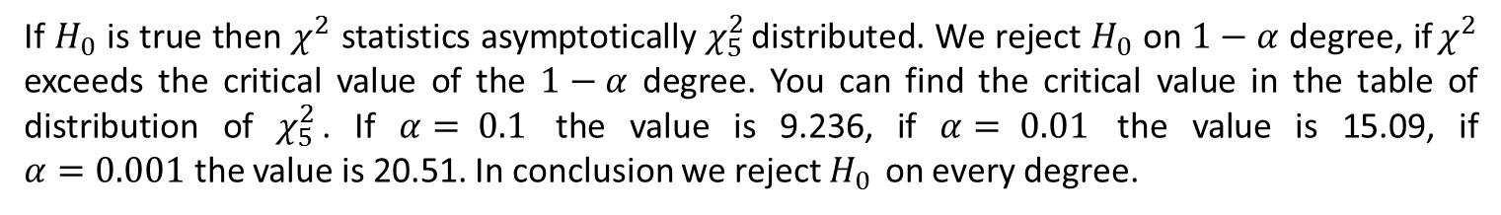
Exercise 1.2
Check is a die is fair or not. Let be $A_{i}$ the event, that we rolled $i$ with the die $(i = 1, . . . , 6)$. Now $H_{0} :P\left(A_{i}\right)=\frac{1}{6}, i=1, . . . , 6.$
We rolled the die 600 times and got the following result:
$$k_{1}=83, k_{2}=91, k_{3}=122, k_{4}=107, k_{5}=74, k_{6}=123$$
($k_{i}$ is the number of cases when the outcome was $A_{i}$).
$$χ^{2}=\frac{{\left(83 − 100\right)}^{2}}{100}+\frac{{\left(91 − 100\right)}^{2}}{100}+\frac{{\left(122 − 100\right)}^{2}}{100}+ \\ +\frac{{\left(107 − 100\right)}^{2}}{100}+\frac{{\left(74 − 100\right)}^{2}}{100}+\frac{{\left(123 − 100\right)}^{2}}{100}= 21.08.$$
If $H_{0}$ is true then $χ^{2}$ statistics asymptotically $χ_{5}^{2}$ distributed. We reject $H_{0}$ on $1−α$ degree, if $χ^{2}$ exceeds the critical value of the $1−α$ degree. You can find the critical value in the table of distribution of $χ_{5}^{2}$. If $α= 0.1$ the value is 9.236, if $α= 0.01$ the value is 15.09, if $α=0.001$ the value is 20.51. In conclusion we reject $H_{0}$ on every degree.

Slide 3
Exercise 1.2
die = 1:6;
freq = [83,91,122,107,74,123];
expected = repmat(100, 1,6) % [100,100,100,100,100,100]
[h,p,stats] = chi2gof(die,"Expected",expected,"Frequency",freq)

Slide 4
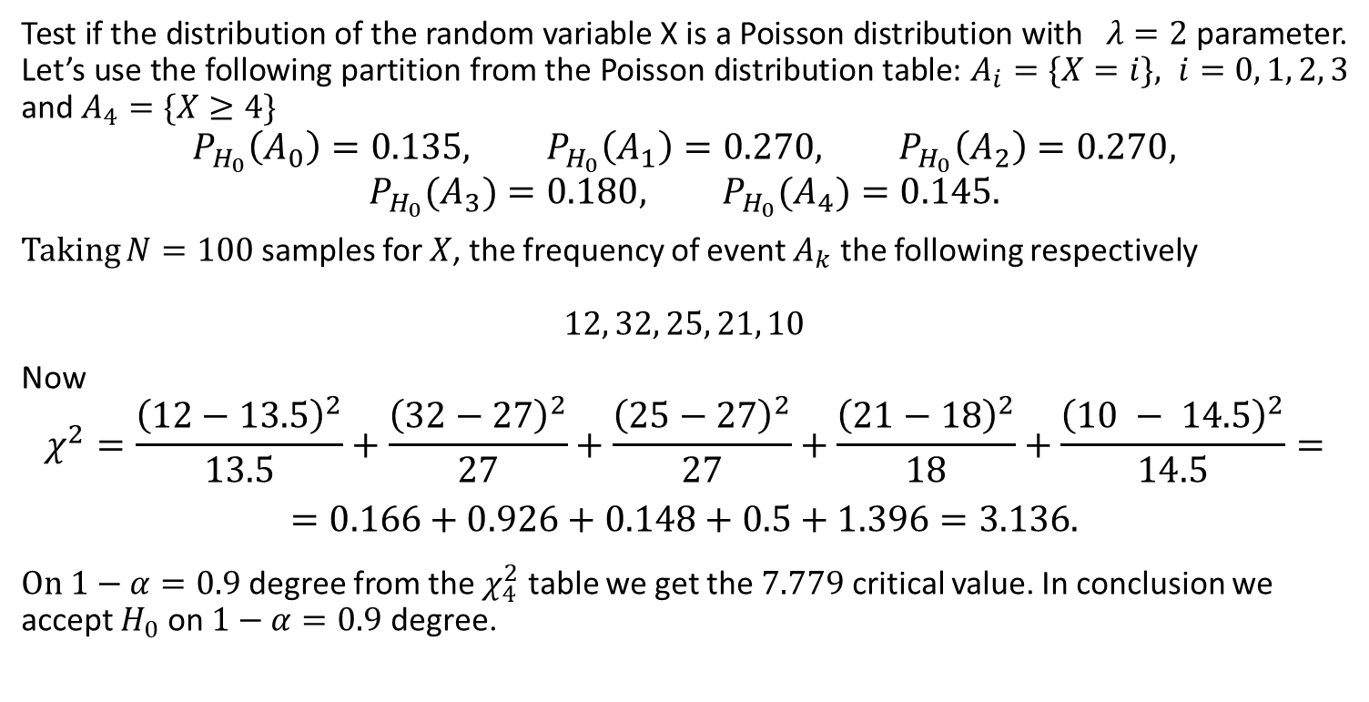
Exercise 1.5
Test if the distribution of the random variable X is a Poisson distribution with $λ=2$ parameter. Let’s use the following partition from the Poisson distribution table: $A_{i}=\{X=i\}, i=0, 1, 2, 3$ and $A_{4}=\{X≥4\}$
$$P_{H_{0}}\left(A_{0}\right)=0.135, P_{H_{0}}\left(A_{1}\right)=0.270, P_{H_{0}}\left(A_{2}\right)=0.270, P_{H_{0}}(A_{3})=0.180, P_{H_{0}}(A_{4})=0.145.$$
Taking $N=100$ samples for $X$, the frequency of event $A_{k}$ the following respectively
$$12, 32, 25, 21, 10$$
Now
$$χ^{2}=\frac{{\left(12−13.5\right)}^{2}}{13.5}+\frac{{\left(32−27\right)}^{2}}{27}+\frac{{\left(25−27\right)}^{2}}{27}+\frac{{\left(21−18\right)}^{2}}{18}+\frac{{\left(10 − 14.5\right)}^{2}}{14.5}=$$
$$=0.166+0.926+0.148+0.5+1.396=3.136.$$
On $1−α=0.9$ degree from the $χ_{4}^{2}$ table we get the $7.779$ critical value. In conclusion we accept $H_{0}$ on $1−α=0.9$ degree.

Slide 5
Exercise
x = 0:4;
freq = [12 32 25 21 10];
prob = poisspdf(0:3,2)
prob = [prob,1-sum(prob)]
expected = prob*sum(freq)
[h,p,stats] = chi2gof(x,"Expected",expected,"Frequency",freq,"Alpha",0.1)

Slide 6
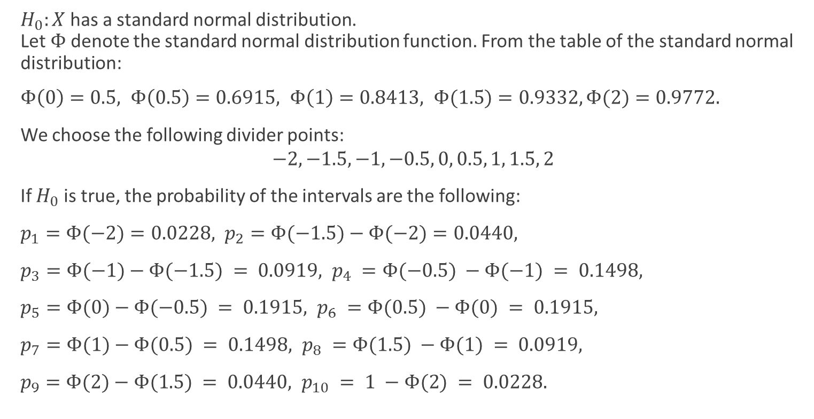
Exercise 1.7
$H_{0}:X$ has a standard normal distribution.
Let $Φ$ denote the standard normal distribution function. From the table of the standard normal distribution:
$$Φ\left(0\right)=0.5, Φ\left(0.5\right)=0.6915, Φ\left(1\right)=0.8413, Φ(1.5)=0.9332,Φ(2)=0.9772.$$
We choose the following divider points:
$$−2, −1.5, −1, −0.5, 0, 0.5, 1, 1.5, 2$$
If $H_{0}$ is true, the probability of the intervals are the following:
$$p_{1}=Φ(−2)=0.0228, p_{2}=Φ(−1.5)−Φ(−2)=0.0440,$$
$$p_{3}=Φ(−1)−Φ(−1.5) = 0.0919, p_{4} =Φ(−0.5) −Φ(−1) = 0.1498,$$
$$p_{5}=Φ(0)−Φ(−0.5) = 0.1915, p_{6} =Φ(0.5) −Φ(0) = 0.1915,$$
$$p_{7}=Φ(1)−Φ(0.5) = 0.1498, p_{8} =Φ(1.5) −Φ(1) = 0.0919,$$
$$p_{9}=Φ(2)−Φ(1.5) = 0.0440, p_{10} = 1 −Φ(2) = 0.0228.$$

Slide 7
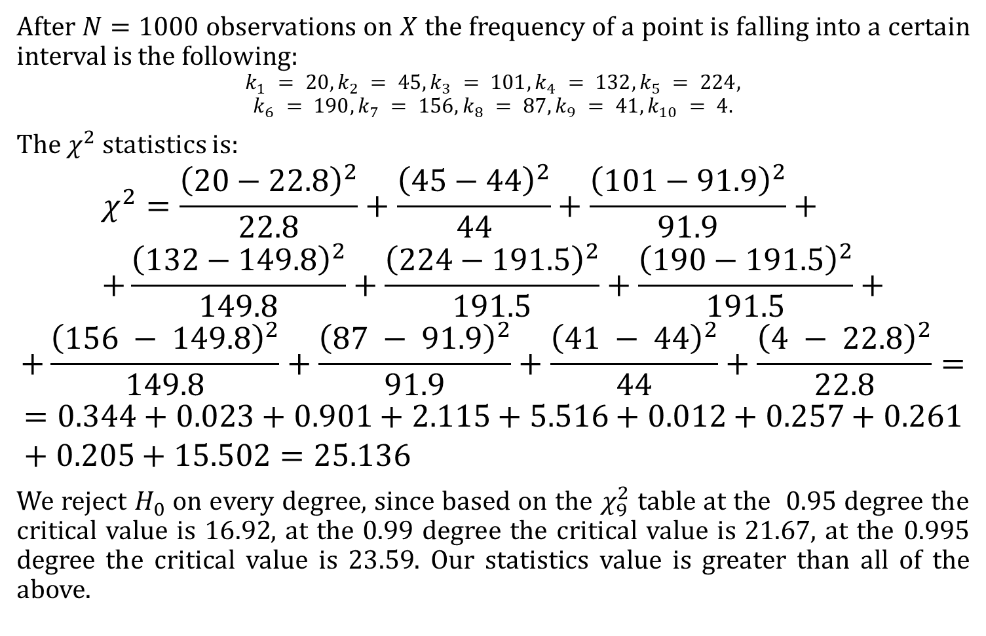
Exercise 1.7
After $N=1000$ observations on $X$ the frequency of a point is falling into a certain interval is the following:
$$k_{1} = 20, k_{2} = 45, k_{3} = 101, k_{4} = 132, k_{5} = 224,$$
$$k_{6} = 190, k_{7} = 156, k_{8} = 87, k_{9} = 41, k_{10} = 4.$$
The $χ^{2}$ statistics is:
$$χ^{2}=\frac{{\left(20−22.8\right)}^{2}}{22.8}+\frac{{\left(45−44\right)}^{2}}{44}+\frac{{\left(101−91.9\right)}^{2}}{91.9}+ \\ +\frac{{\left(132−149.8\right)}^{2}}{149.8}+\frac{{\left(224−191.5\right)}^{2}}{191.5}+\frac{{\left(190−191.5\right)}^{2}}{191.5}+$$
$$+\frac{{\left(156 − 149.8\right)}^{2}}{149.8}+\frac{{\left(87 − 91.9\right)}^{2}}{91.9}+\frac{{\left(41 − 44\right)}^{2}}{44}+\frac{{\left(4 − 22.8\right)}^{2}}{22.8}=$$
$$=0.344+0.023+0.901+2.115+5.516+0.012+0.257+0.261+0.205+15.502=25.136$$
We reject $H_{0}$ on every degree, since based on the $χ_{9}^{2}$ table at the $0.95$ degree the critical value is $16.92$, at the $0.99$ degree the critical value is $21.67$, at the $0.995$ degree the critical value is $23.59$. Our statistics value is greater than all of the above.

Slide 8
Exercise
freq = [20 45 101 132 224 190 156 87 41 4];
edges = [-2 -1.5 -1 -0.5 0 0.5 1.5 2];
expected = [normcdf(-2),normcdf(-1.5:0.5:2)-normcdf(-2:0.5:1.5),1-normcdf(2)]*sum(freq)
[h,p,stats] = chi2gof(-2.25:0.5:2.25,"Expected",expected,"Frequency",freq)

Slide 9
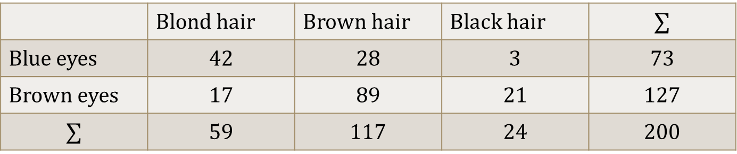
Exercise 1.8
Are the hair and eyes colour independent? After observing 200 people we got the following table:
 | Blond hair | Brown hair | Black hair | $$∑$$
Blue eyes | $$42$$ | $$28$$ | $$3$$ | $$73$$
Brown eyes | $$17$$ | $$89$$ | $$21$$ | $$127$$
$$∑$$ | $$59$$ | $$117$$ | $$24$$ | $$200$$
$$χ^{2}=\frac{{\left(42−21.54\right)}^{2}}{21.54}+\frac{{\left(28−42.71\right)}^{2}}{42.71}+\frac{{\left(3−8.76\right)}^{2}}{8.76}+\frac{{\left(17−37.47\right)}^{2}}{37.47}+\frac{{\left(89−74.30\right)}^{2}}{74.30}+\frac{{\left(21−15.24\right)}^{2}}{15.24}=$$
$$= 19.43 + 14.71 + 3.79 + 11.18 + 2.91 + 2.18 = 49.11.$$
The degree of freedom is $(2−1)(3−1)=2$. Since in the table of $χ_{2}^{2}$ even the $α=0.001$ degree’s critical value is $13.82$, we reject $H_{0}$ at all possible degrees.

Slide 10
Exercise
function [h,p,X2] = chi2cont(x,alpha)
e = sum(x,2)*sum(x)/sum(x(:));
X2 = (x-e).^2./e;
X2 = sum(X2(:));
df = prod(size(x)-[1 1]);
p = 1-chi2cdf(X2,df);
h = double(p<=alpha);
cont = [[42;17],[28;89],[3;21]];
[h,p,x2] = chi2cont(cont,0.05)

Slide 11
Literature
Ágnes Baran: Mathematics for engineers 1. (Laboratory slides)
Sándor Baran: Probability theory and statistics
Fazekas István: Valószínűségszámítás, Debreceni Egyetemi Kiadó, 2009
Fazekas István: Bevezetés a matematikai statisztikába, Debreceni Egyetemi Kiadó, 2009
Matlab examples: https://www.mathworks.com/help/examples.html

